Slide 1




Lessons in 2021
Outlook for 2022
Practice over Theory

Slide 2

Introduction
Lessons in 2021
Outline
Outlook for 2022
Conclusion
02

Slide 3


Introduction (1)
We live in an ever-changing compliance environment driven by technology, new generation of customers, very high demands & expectations under a global ecosystem.
Working-From-Home(WFH) has now become Working-From-Anywhere(WFA).
We are also at the threshold of the Metaverse and Web 3.0 with 5G internet access now operational.
These new innovations will challenge old models of regulatory thinking.
There is the need to look at the trends and patterns of AML/CFT Compliance and focus on what needs to be done in 2022.
03

Slide 4

Introduction (2)
As Compliance Practitioners, we must always think ahead in order to avoid some of the acts of omission and commission that result in regulatory non-compliance.
The digital revolution is upon us.
Compliance must therefore harness Technology to transform our deliverables.
We must build digital compliance platforms using technology and data that deliver speed, security and convenience to our customers.
We must embrace a ‘’Customers’ Digital Onboarding Platform’’ that will give customers contactless KYC/CDD.
Compliance should prepare for the full Open Banking Phase where banks compete for services rather than for customers.
04

Slide 5
FATF Strategy Focus in 2021 (1)
COVID-19 Crime
Environmental Crime
Counterfeiting of medical goods
Investment Fraud (Ponzi Schemes)
Cyber-crime scams
Stimulus Fund Scam
Understand how criminals and terrorists can exploit the COVID-19 pandemic
Encourage the use of technology (FinTech, RegTech & SupTech) to ensure continuation of financial services & payment
Illegal trade in wildlife
Forestry Crime
Illegal Mining
Waste Trafficking
Consider ML risks from EC
Strengthen inter-agency coordination
Bridge knowledge gap
Banks, Dealers in Precious metals & stones, lawyers, trust & company service providers should understand the risk
05

Slide 6



FATF Strategy Focus in 2021 (2)
Digital Transformation
Illicit Arms Trafficking & Terrorist Financing
Understand opportunities & challenges of New Technologies
Data Pooling, Collaborative Analytics & Data Protection
Digital transformation of AML/CFT for operational agencies – detection of suspicious activities and analysis of financial intelligence
Create an enabling environment for innovation
Ensure privacy and data protection when implementing new technologies
Develop and communicate policies and regulatory approaches to innovation that are flexible, technology neutral, outcome based and in line with RBA
Understand the links between arms trafficking and terrorist financing
Terrorist attacks often use illegally trafficked weapons and illicit arms trade is a predicate offence
Illicit arms trafficking provides lucrative source of funding for terrorists and terrorist group
06

Slide 7
FATF Strategy Focus in 2021 (3)
Ethnically or Racially Motivated Terrorism Financing(EoRMT)
Unintended Consequences of the FATF Standards
Extreme Right-wing groups obtain funding from legal sources such as donations, membership fees and commercial activities
Designate extreme right-wing groups as terrorists
Develop awareness programs on EoRMT
FATF standards are sometimes misinterpreted or misapplied in ways that can lead to social, economic and political challenges resulting in unintended consequences
Mitigate against De-risking or the loss or limitation to access financial services
Mitigate against financial exclusion
Mitigate undue targeting of NPOs
Mitigate the curtailment of human rights
07

Slide 8
FATF Strategy Focus in 2021 (4)
Strengthening the Global Network
Beneficial Ownership
Underlining the importance of enhancing cooperation with the FSRBs
High-level Engagement with FSRBs and their members
Strengthening capacity to prioritize and address FSRBs internal challenges
Increased involvement of FATF members in support activities for FSRBs
FATF Participation in G20, G7, G20 Anti-Corruption Working Group (ACWG)
Complex corporate structures such as Foundations and Partnerships with limited liability continue to enable criminals to hide their identity and illicit gains
Countries should make up-to-date beneficial ownership information available
Improve the transparency of corporate structures
08

Slide 9

FATF Strategy Focus in 2021 (5)
Smuggling of Migrants
Asset Recovery
Art and Antiquities used for ML & TF
Terrorist organisations are exploiting smuggling networks to fund and support their activities
ISIL, AL-Qaeda and affiliate have relied on human smuggling to generate proceeds
Terrorist supporters have relied on migrant smuggling networks to travel to and from conflict zones
Asset recovery remains one of the most effective actions against ML & TF
Countries should put framework in place to achieve this
The art market presents the ideal properties to make it attractive to launder proceeds of crime
There is a veil of secrecy on transactions
There is no stable or predictable pricing
Buyers and sellers often rely on intermediaries and shell companies
Terrorist groups have plundered and sold cultural heritage items and artefacts from conflict zones
09

Slide 10

The US Anti-Money Laundering Act of 2020 (AMLA) comprises of the Corporate Transparency Act (CTA) which provides for:
Lessons from the US
Establishment of a beneficial ownership registration database
Expanded authority to subpoena foreign banks
New penalties for misrepresenting or withholding information
Streamlined automated filing of non-complex suspicious activity reports
Expanded whistleblower rewards and protections
Expanded regulatory oversight
Establishment of national AML priorities
Information sharing with foreign branches, subsidiaries, and affiliates
Further government analyses, studies, reports, and rules
10

Slide 11
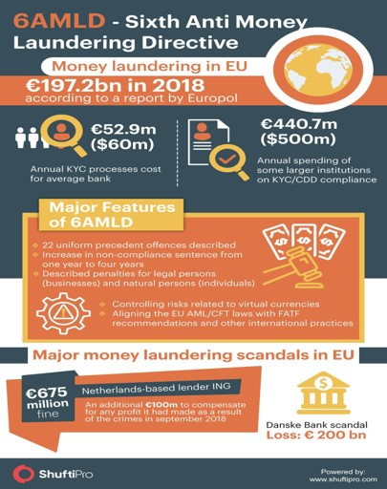
Lessons from the EU
Dual criminality for specified offences & greater co-operation
Harmonization & clarification of predicate offences
Extension of criminal liability to legal persons
A tougher punishment regime overall
Additional offences such as aiding & abetting
The 6AMLD came into effect on 3/12/20. The deadline for implementation by Fls & DNFBPs in the EU was 3/6/2021
It is not about fulfilling minimum regulatory requirements but about changing the attitude towards AML/CFT Compliance
11

Slide 12
OTHER HEADLINES FOR 2021
The Pandora Papers
  More action needed on UBO
  Adverse Media Check Obligatory
  PEPs Screening key
Human Rights Sanctions On the Card
  Magnitsky Act an Inspiration
  Human Rights Abuses Sanctions.
ESG Risk Assessment & Compliance
Sanctions Hotbeds
  Russia, Myanmar, Belarus, China, North Korea, Afghanistan
04

Slide 13
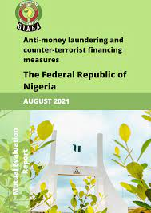
Nigeria’s understanding of key ML Risks (i.e. Legal Persons, PEPs, FTZs) are underdeveloped
The use of Financial Intelligence by LEAs remains limited
Limited or lack of coordination among LEAs and other Security Agencies
Nigeria lacks an explicit policy to confiscate the proceeds and instrumentalities of crime
The understanding of ML/TF risks varies across the private sector
SCUML lacks the resources to supervise DNFBPs
CAC does not have a mechanism in place to systematically collect and maintain BO information
Nigeria did not demonstrate effective legal and operational framework for seeking international cooperation
Nigeria has incomplete understanding of its TF threats and risks
Nigeria has not conducted a sectoral risk assessment of NPOs and does not implement Targeted Financial Sanctions (TFS)
Governance Structure for AML/CFT Compliance is considered to be Ineffective
Highlights of 2021 MER
12

Slide 14
Regulatory Highlights in 2021
January 18th, 2021
February 5th, 2021
February 17th, 2021
July 27th, 2021
Sandbox and Compliance Innovations
Crypto Ban
October 12th, 2021
Regulatory Framework for Open Banking in Nigeria
CBN Bans Forex Sale to BDCs
October 25th, 2021
BVN & Watchlist
eNaira Launch

Slide 15

eNaira & Compliance
Facts
Compliance Concerns
Launched by the President on 25th October, 2021
eNaira is an example of a Central Bank Digital Currency(CBDC)
This is a part of CBN monetary policies
It is the digital version of the country’s national currency
It is issued by the CBN
Before now digital currency was only accessible to Banks & other FIs but now the CBN wants to make it available to everybody
It creates new opportunities for payments and the way the CBN manages the monetary policies
It is not a Virtual Asset
Functions on existing KYC & AML/CFT Compliance infrastructure
ML/TF/PF risks associated with cross-border fund transfers and agency banking
Cybersecurity
Data Protection
Legal cases
Financial Integrity
ML/TF/PF Risk Assessment of eNaira
14

Slide 16
Hushpuppi & The Super Cop: Lessons
Pay attention to what goes on with your customers & clients on Social Media
Pay close attention to Social Media Influencers & those displaying wealth and transaction patterns of your customers/clients
Watch Adverse Media mention of your customers & their associates
LEA Officers(irrespective of rank) are now complicit. Monitor accounts of LEAs for SAR/STR
Notable Lessons from the case of Hushpuppi the Billionaire Gucci Master & the Super Cop
15

Slide 17
Actors & Players
Hotbeds
-Lagos (Lekki/1004/Ikorodu)
-Abuja -Benin -Asaba -Abeokuta -Owerri, -Ado-Ekiti -Ibadan -Osogbo -Ijebu-ode -Ogbomoso
-Mostly Youth & Undergraduate students
-G-boys
Yahoo-Yahoo Ecosystem
Enablers
- IMTOs, Gift Cards, TBML, Hotels -Lounges -Clubs - Luxury Shops -Car Shops -Boutiques
16

Slide 18

Outlook for 2022

Slide 19
Determinants
Post-Covid Hangover
Elections & Politicking
Woke Generation Demands
Compliance Automation
Compliance Decentralization
Influence of Social Media
NRA Update Demands
New Legislations & Regulations
Yahoo Boys & Girls now a growing population of customers
Internet Fraud New Typologies
Cybercrime & Cybersecurity
Virtual Assets & VASPs
18

Slide 20
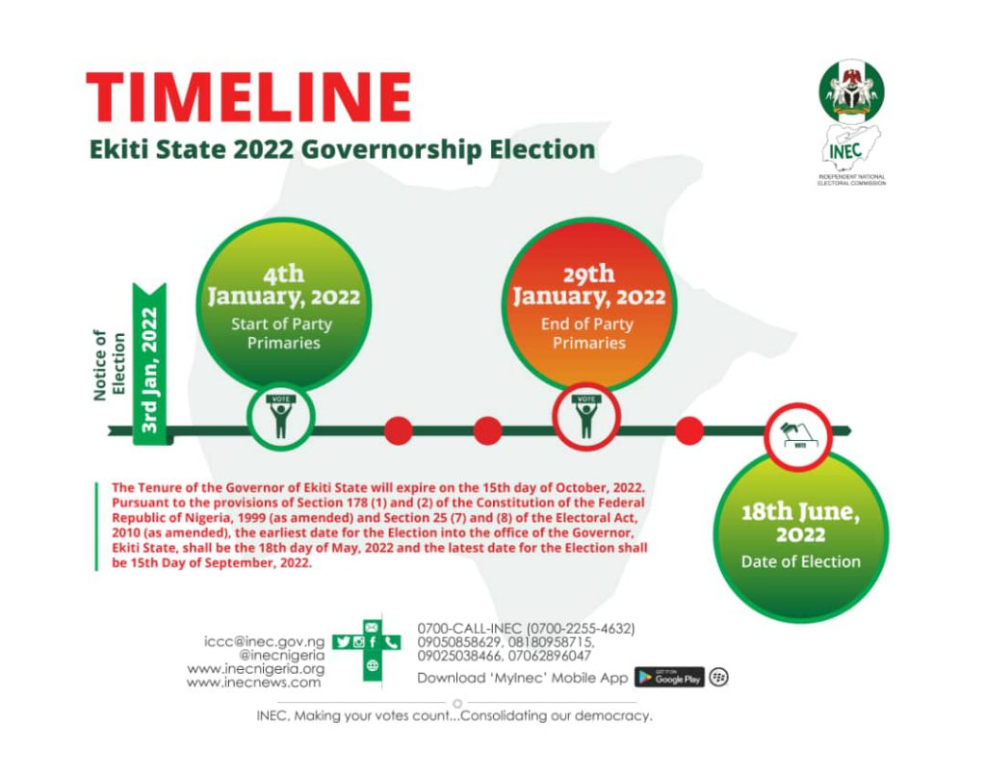
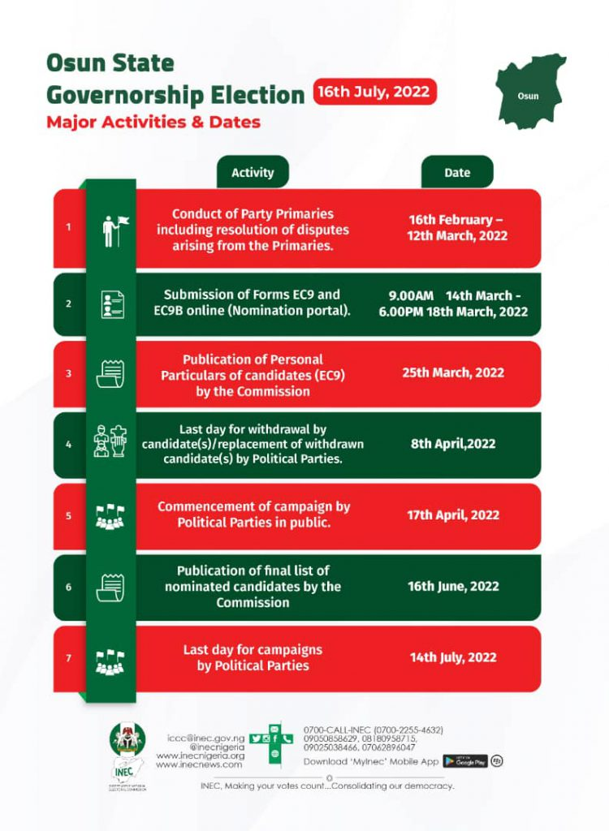
Elections & PEPs
19

Slide 21
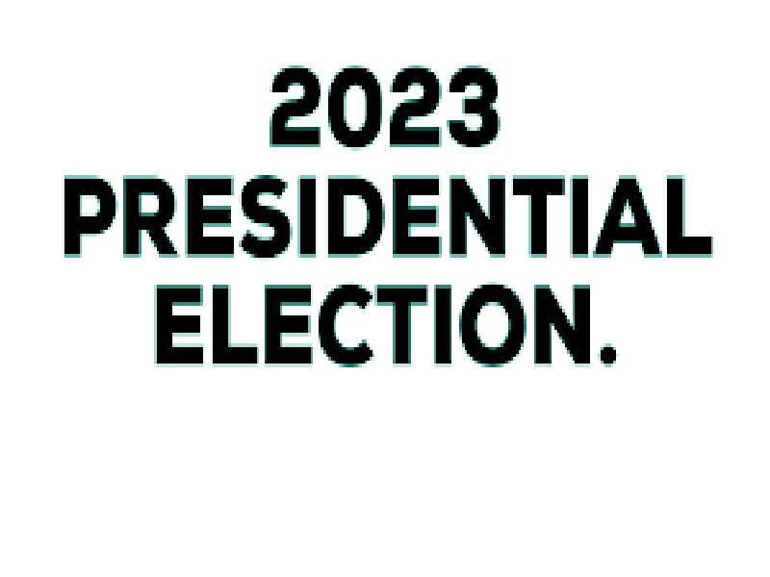

General Election in 2023
20

Slide 22
High volume of Cash Transactions
Frequent demand for Cash
Partisan/Campaign Solidarity from Bank, Branch, Board, Management & Staff
Donations/Financial Support Solicitation
3rd Party Dealings
Use of Shell Companies
Transactions through Close or Business Associates
PEP Redflags
21

Slide 23
Put in place mechanism to identity all PEPs
Extend identification to Close & Business Associates
Training & Awareness for Staff & Management
Review/update KYC Records for PEPs
Monitor all PEPs Transactions
Keep Records of PEPs Transactions
Report STR/SAR
Render monthly reports to CBN
PEP Risk Management
22

Slide 24
Upcoming Legislation (1)
1. To amend the existing BEDA Act of 1986
2. To expand the application of the law to cover all FIs i.e. Banks, CMOs, Insurance, Penops, etc.
3. Propose to ban bank employees from operating foreign accounts
Bank Employees, etc. (Declaration of Assets) Amendment Act, 2022 (BEDA Act)
23

Slide 25
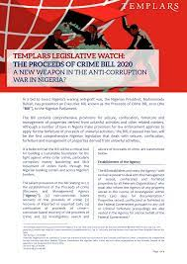
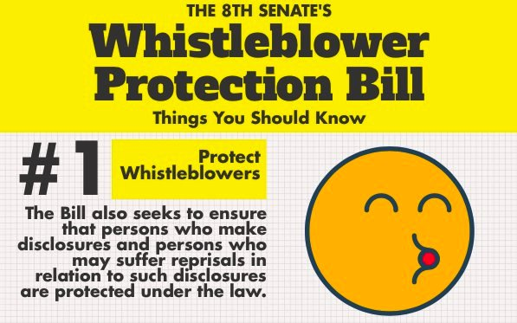
Upcoming Legislation (2)
24

Slide 26


Upcoming Legislation (3)
Money Laundering (Prevention and Prohibition) Bill and Money Laundering (Prevention and Prohibition) (Repeal & Re-enactment) Bill
25

Slide 27
Upcoming Laws and Compliance Implications
ACCOBIN should make presentations to the national assembly on all these upcoming bills and declare awareness days to sensitize the industry and the general public about some of the provisions that do not meet international standard/benchmark
AML/CFT Compliance Training is considered to be Ineffective
26

Slide 28
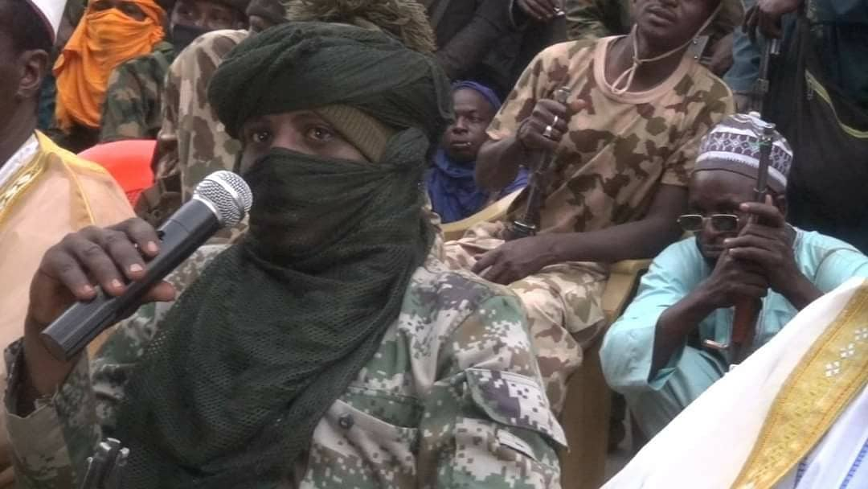
Dago Gide (aka Abubakar Abdullahi : Group Leader
Sani San Makama
Buharin Daji (Deceased): Killed in 2018
Damina (Deceased)
Mai Anguwa : Group Leader
Turji Bello : Group Leader
Alhaji Auta(Deceased): Killed in 2021
Kundia
Kungiyar Barayin Shanu (Cattle Rustlers Association)
Kungiyar Gaya Group (Association of Young guys)
Alhaji Isshe (Deceased): From Chilin, Dan Sadau Emirate, Maru LGA, Zamfara State
Aliyu Zakwai (Son of Buharin Daji killed in 2018
Alhaji Altire (From Zamfara State)
Shehu Rekep (From Zamfara State)
Musa Yellow Janbross (From Kaduna State)
Know-Your- Bandit
27

Slide 29
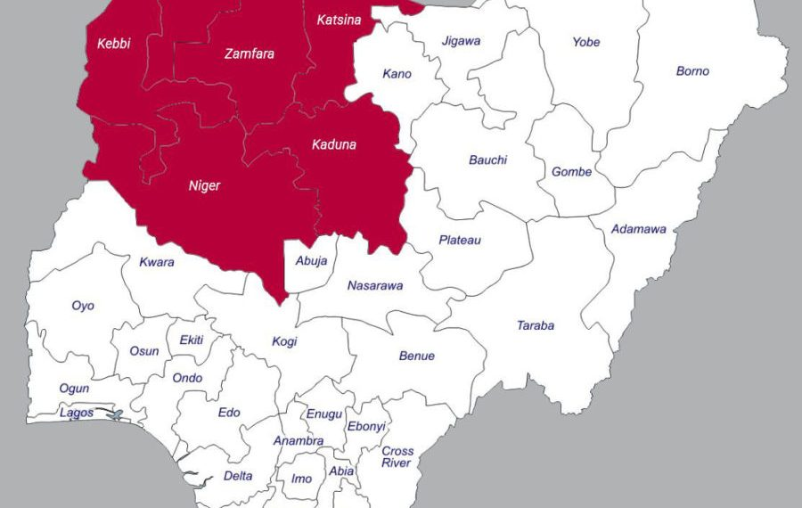
Bandits: High Risk Locations
AML/CFT Compliance Training is considered to be Ineffective
28

Slide 30
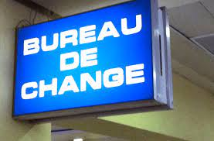
BDC Sector Risk
Deposit Money Banks and other Financial institutions need to continue to treat BDCs as High Risk customers in 2022 due to inherent weaknesses in supervisory control and operational deficiencies.
BDCs vulnerabilities include:
  - Misuse/Abuse by PEPs
  - Unlicensed Operators
  - Inadequate KYC process
  - Poor Record Keeping
  - Reporting Failure
Needed STR/SAR should be filed with the NFIU
29

Slide 31


Slide 32

Questions?

Slide 33
Copy Right
@
DataPro Limited
Ground Floor, Foresight House
163/165 Broad Street, By Marina Waterfront, Lagos Island, Lagos.
 234-803-309-1467
E-mail: adeseyoju.abimbola@datapronigeria.net
Website: www.datapronigeria.net

