Slide 1
Terrorism Financing
ACCOBIN Annual Retreat
24th February 2022

Slide 2

Terrorism Financing
What is it?
  Nigerian Laws – Section 4(3)(d)of TP Act 2011- support” –…provision of financial or other related service”
  United Nations – Article 2 on the international convention on the suppression of Terrorism
    By any means, directly or indirectly, unlawfully, and wilfully, provides or collects funds with the intention that they should be used or in the knowledge that they are to be used, in full or in part, in order to carry out……
  African Union – article (1)(3)(b) – defines TF as a Terrorist Act where it says: “any promotion, sponsoring, contribution, command, aid, incitement, encouragement, attempt, threat, conspiracy, organizing or procurement of any person with the intent to commit any act referred to in paragraph (a)(i) – (iii) above….

Slide 3



Terrorism Financing – Nigeria and West Africa
Smuggling of
arms, assets and currencies by cash couriers
Trade and other legitimate activities
Charity organisations (NGOs, etc.)
Violent crimes and drug trafficking
Terrorist financing through multiple channels

Slide 4





Challenges on Tracking Terrorism Financing
Dynamic
nature of crime
constantly evolving
Technology Inadequate use of information and communications technology (ICT)
Ungoverned spaces and weak border controls
Poor or lack of coordination and synergies between LEAs

Slide 5


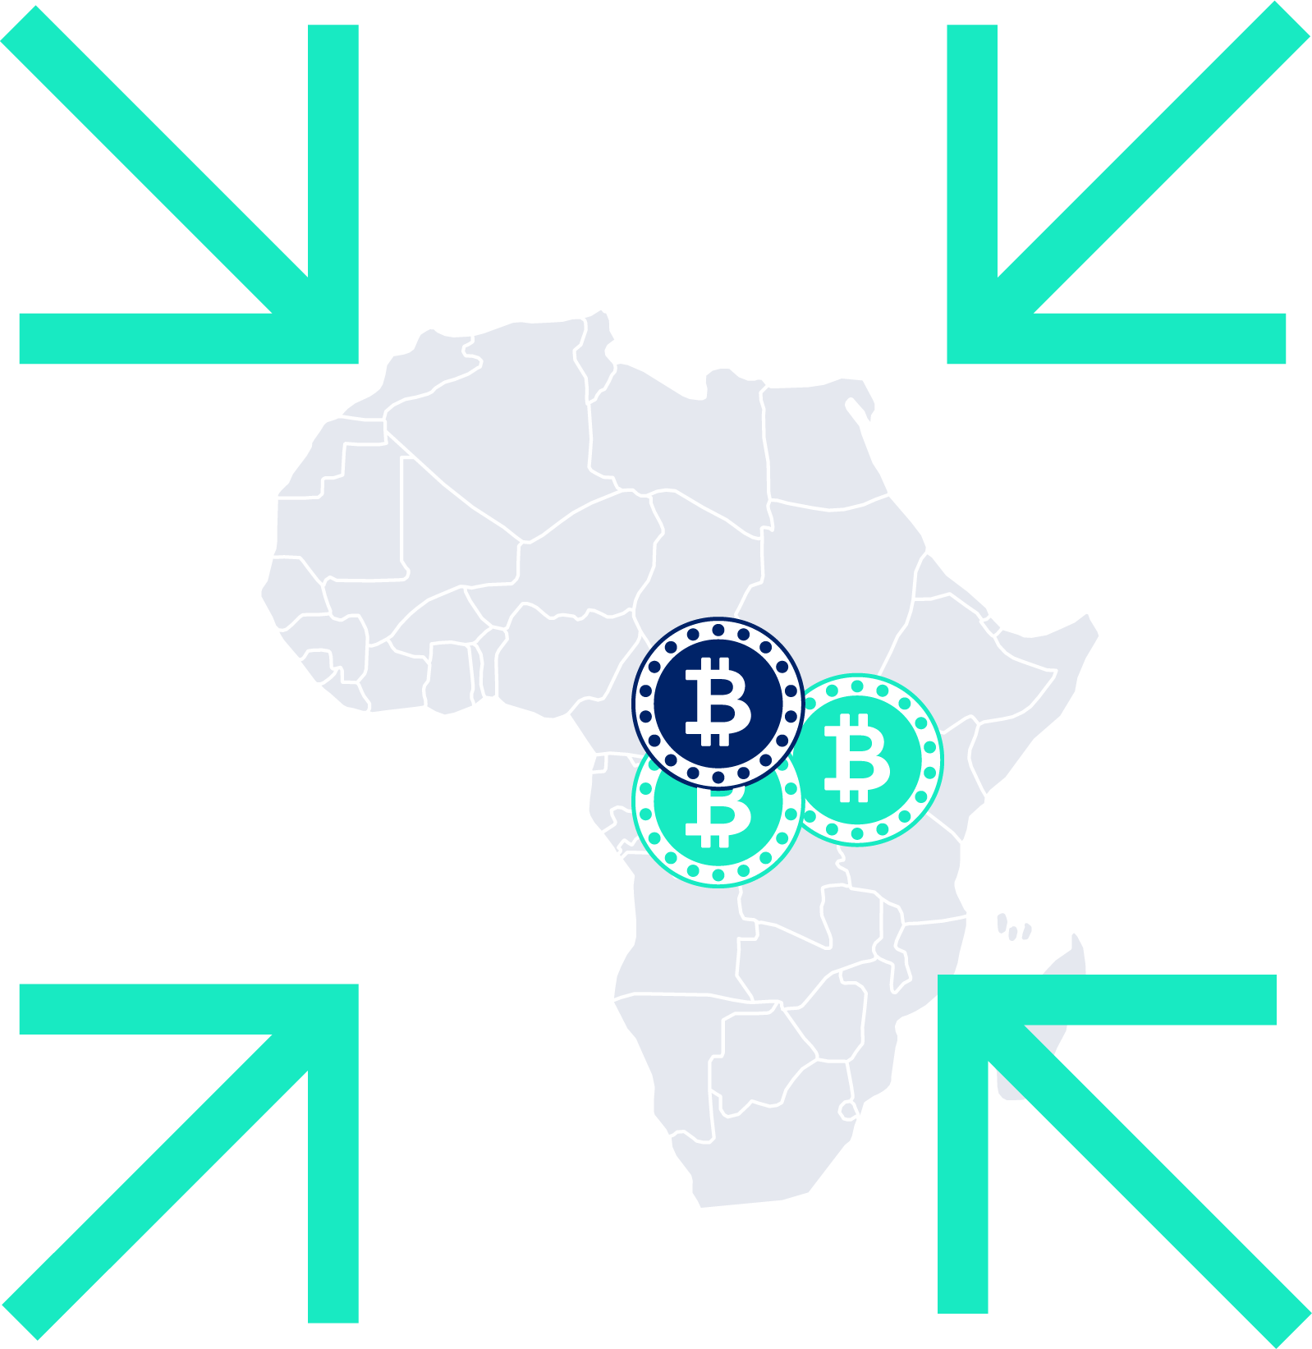
Key Takeaways
Terrorist groups in
Africa have strong links
with international
terrorist organisations
Terrorism financing in
Sub-Saharan Africa is funded through movement of bulk cash obtained by violent crimes, arms and ammunition sales and petty and sales and moved through smuggling of items where value is transferred across borders
Use of other means
like Hawala and virtual currencies for terrorism financing is minimal in the Sub-Saharan Africa

Slide 6
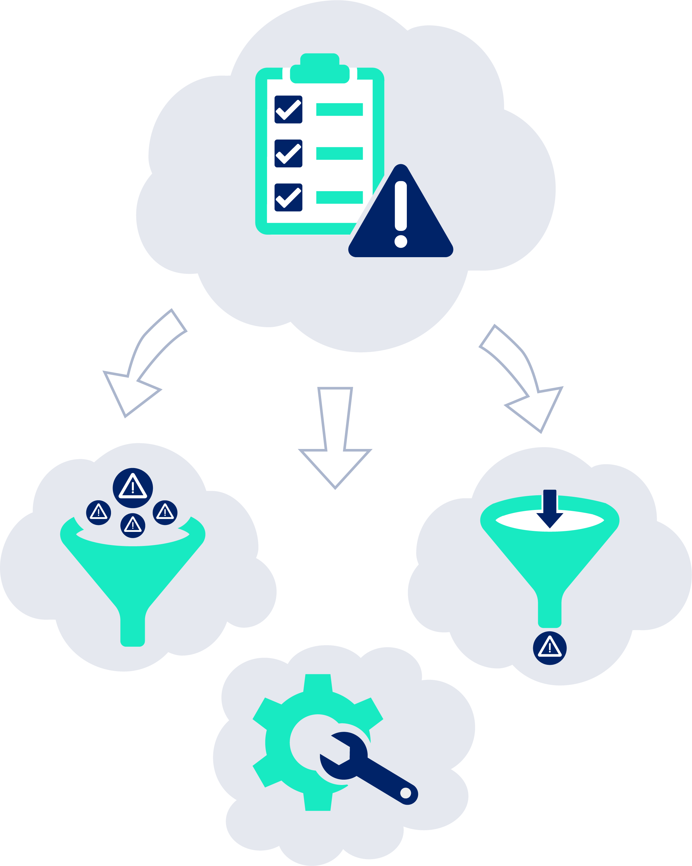

Tools and Techniques to Detect Terrorism Financing
Technology is useless without the basic knowledge and its implementation. These are:
Main key control is:
Sound AML programme
Risk assessment capturing inherent risks, controls and residual risks
Partnerships with law enforcement/FIU and regulators
Sound audit function and compliance functions
  Transaction Monitoring

Slide 7




Automating Transaction Monitoring Systems (Key Element)
Continuous transaction monitoring:
Of specific sectors already identified as vulnerable for
terrorist financing
NPOs, DNFBPs, etc
Of products – software providers can offer to proactively detect payments indicative of terrorism
Wire transfers or alternative remittances
Conventional transfer mechanisms: Account
to account (intrabank and Interbank)
Other transfer mechanisms systems: WUMT,
Moneygram, RIA, etc
Alternative remittance systems: Hawala, Hundi,
etc, others (where they are regulated)
Exchanges and custodians
Crypto-currency exchanges
Who is being paid? Who is buying, who is selling and
who is paying etc

Slide 8





Identifying Patterns Indicative of Terrorist Financing
For higher risk customers, the following indicators may be additionally applied
Transactions that fall just under reporting thresholds
Once a composite risk score is produced, revisit
the risk score using any transactional history
Continually and automatically monitor and update risk ratings without human intervention
Where risk scores change, these should be investigated as alerts

Slide 9


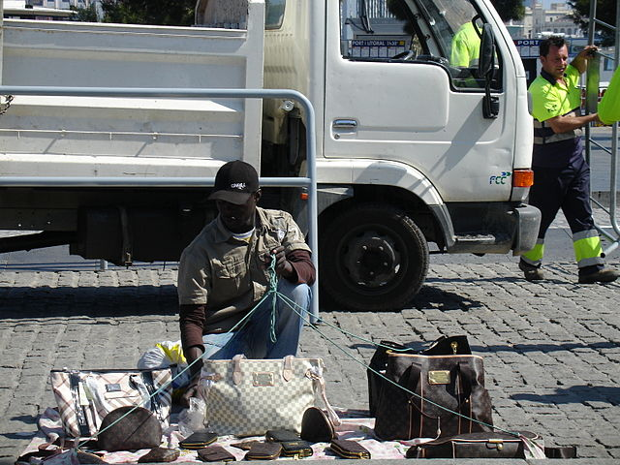
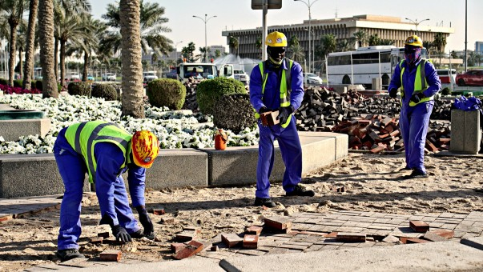

Monitor vulnerable trade accounts
Appropriate risk rating and transaction monitoring is a must!
Target businesses that
conduct Hawala by the side:
Street Hawkers
Indicators of possible ransom flows:
Structured deposits
at Banks
Frequency and amounts, etc.
Sender/destination locations
Funds from different senders and/or locations within
same time period
Blue Collar Jobs
Focus on
- 3rd tier accounts
- Artisans
Barbers and Hair Saloons, etc
This Photo by Unknown Author is licensed under CC BY-SA

Slide 10


Cash Transactions
Monitoring the following for detection of payments:
Cash payments deposits and payments
(usually below reporting thresholds and in cash)
Look for smurfing and money muling
Source of payments (channels of payments/originators)
Monitor different payment locations and channels
Transfers
Use of PoS terminal agents to smurf,
Use of Internet and Mobile Banking platforms for a fee
Other purchases online through such virtual platforms

Slide 11


Questions???
Thank you!
Abdul Rahman, M. Mustapha
Mo & Associates
+234 803 451 4052
amustapha@moandassociates.com
Slides – Courtesy of ACAMS.org

