Slide 1
LECTURE DELIVERED
BY
ROSELYN IGIO IZUAGBE
FEBRUARY, 2022

Slide 2
TOPIC
TERRORISM AND TERRORISM FINANCING IN WEST AFRICA

Slide 3
PRESENTATION OUTLINE
Introduction
Definition of terms
Terrorist organisations in West Africa
Terrorist financing in West Africa
Efforts to quell the phenomenon
Challenges to the efforts
Way forward
Conclusion

Slide 4
INTRODUCTION
Nations are exposed to internal and external threats which disrupt security.
Developed and developing countries of the world, are faced with crimes ranging from kidnapping, militancy, armed robbery, money laundering, insurrections to terrorism among others.

Slide 5
INTRODUCTION CONT’D
Specifically, terrorism is increasingly a global problem that requires concerted global action.
It negatively affects human lives, destabilises government and undermines economic and social development.
Like every other crime, terrorists explore different funding means to ensure that they perpetuate their activities.

Slide 6
INTRODUCTION CONT’D
This ranges from members’ donations, support from wealthy individuals. Drug trafficking, state sponsorship, tax and levies on communities, kidnapping for ransom, hijacking (International Centre for Counter Terrorism, 2020) among others.
The sheer array of sources of funds for terrorist organisation is alarming.
In nations where terrorism thrives national security has equally been compromised.

Slide 7
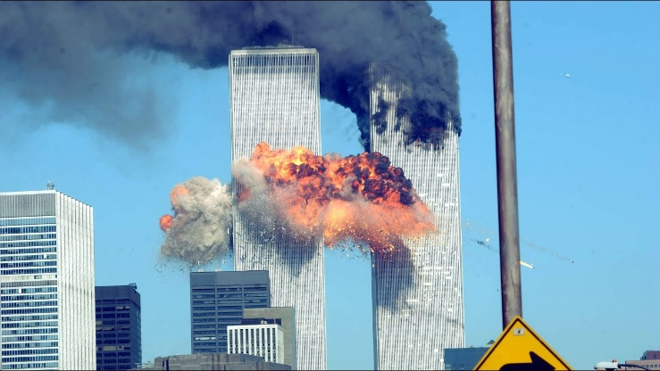
INTRODUCTION CONT’D
Following the September 11, 2001 attack popularly called 9/11, the United States of America (USA) investigation of the source of funding of the Al-Qaeda terrorist organisation that perpetrated the act disclosed that,
Source: www.google.com

Slide 8
INTRODUCTION CONT’D
they explored both the formal financial systems and charitable organisations to raise about thirty (30) million dollars per year in the period preceding the attacks.
Source: www.google.com

Slide 9
INTRODUCTION CONT’D
International religious charities and business were used to source and protect the funds raised.
The charities encouraged donations and used the funds for lawful humanitarian relief which were later recouped to aid Al-Qaeda activities.

Slide 10
INTRODUCTION CONT’D
Sympathisers and deep pocket donors contributed via these charities to procure facilities required for Al-Qaeda logistical and operational needs (Argenti, 2002; Comras, 2005).
10

Slide 11
INTRODUCTION CONT’D
This might not be unconnected with the fact that the United States has a large, complex and open financial system making it a destination for legitimate trade and investments, but also a target for illicit activity and actors (Szubin, 2018).

Slide 12
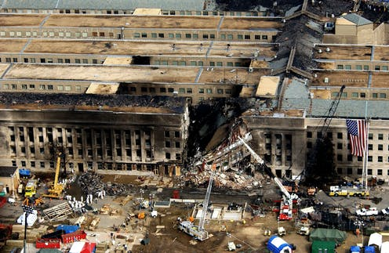
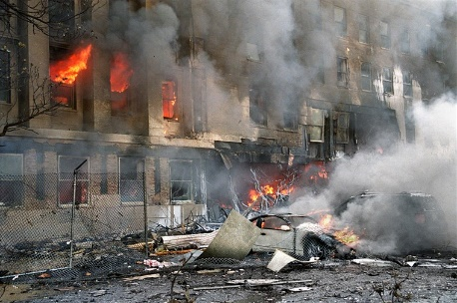
INTRODUCTION CONT’D
The 9/11 Commission reported that Al-Qaeda facilitated its operations through these channels.
The devastating attack led to the death of three thousand (3,000) people, loss of three hundred thousand (300,000)
Source: www.google.com

Slide 13
INTRODUCTION CONT’D
communication facilities, displacement of twenty thousand (20,000) residential customers, knocked out over four million data circuits, set back fourteen thousand (14,000) businesses and deactivated ten cellular towers (Argenti, 2002; Comras, 2005 ).
Source: www.google.com

Slide 14
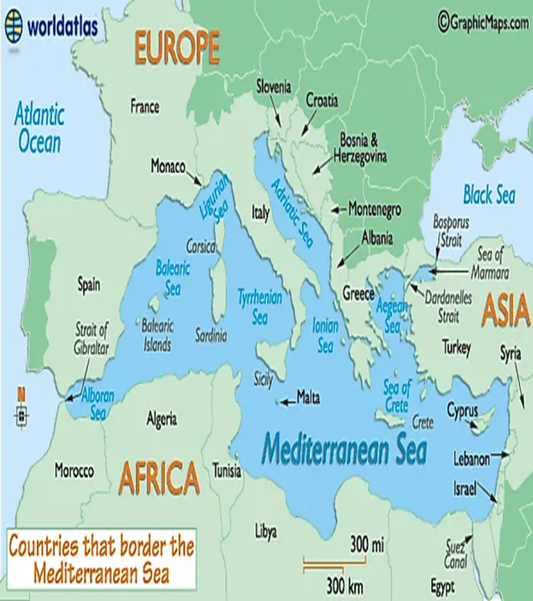
INTRODUCTION CONT’D
In Europe, terrorists maintain their operations through access to several means of funding.
Formed in 1969, the traditional activities of the Irish Republic Army (IRA) included armed torture, assassinations, suicide bombings, extortions, armed robberies and kidnappings.
Source: www.google.com

Slide 15
INTRODUCTION CONT’D
In 2004, the organisation was involved in two (2) robbery operations where they stole over forty-two million Euro (Pike, 2005).
Source: www.google.com

Slide 16
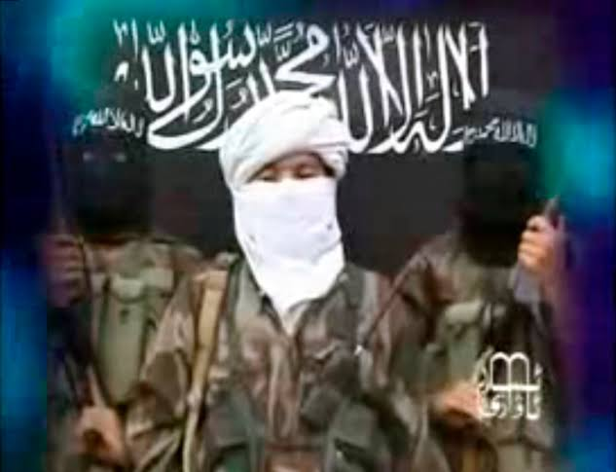

INTRODUCTION CONT’D
In India, infusion of money into terrorist activities has been linked to narcotics trade in the Afghanistan-Pakistan (AfPak) area,
Source: www.google.com

Slide 17
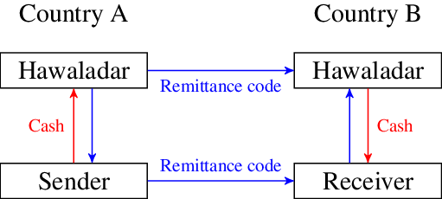
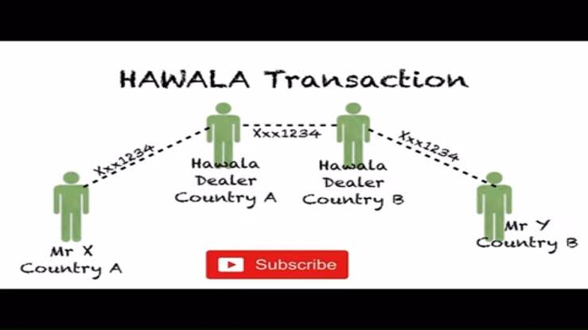
INTRODUCTION CONT’D
Of major importance is that monies to execute terror are routed through the hawala system which refers to the cohesiveness of a large network of money brokers in these countries.
Over the years, this has emerged to be the biggest network for giving money to terrorists (Chadha, 2015).
Source: www.google.com

Slide 18
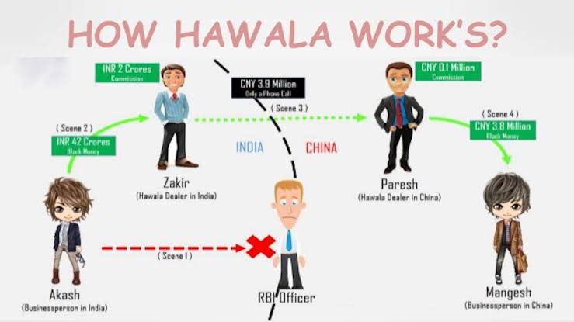
INTRODUCTION CONT’D
Source: www.google.com

Slide 19
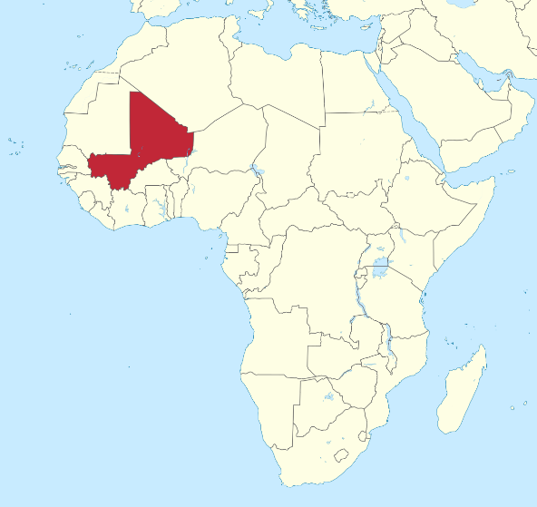
INTRODUCTION CONT’D
In Africa and the Middle East terrorist organisations are receiving funds from a plethora of sources.
With these financial backings, they are increasing attacks against the people and governments.
Source: www.google.com

Slide 20
INTRODUCTION CONT’D
In Egypt, Ansar Bayt al-Maqdis (ABM) now Islamic State in Syria Sinai Province (ISIS-SP) was officially designated a terrorist organisation in 2014.
On 4th November, 2015, the organisation claimed responsibility for bombing a Russian passenger plane in Egypt’s Sinai Peninsula.
Source: www.google.com

Slide 21
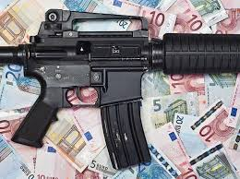
INTRODUCTION CONT’D
All the two hundred and twenty-four people onboard died.
Although it is unclear how it sources its funds, there are indications that the group receives financial support from Islamic State in Syria (ISIS) (USDOS, 2019).
Source: www.google.com

Slide 22
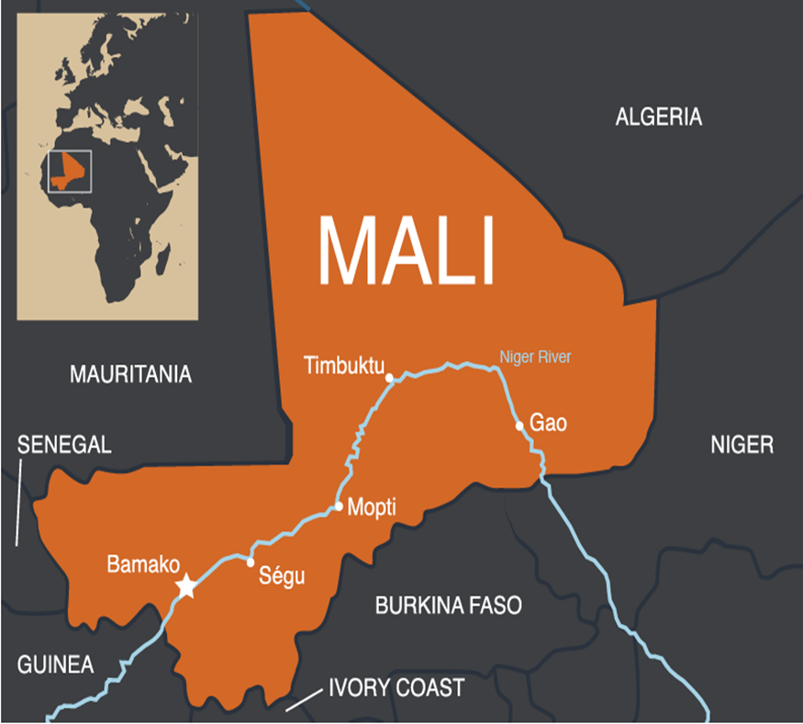
INTRODUCTION CONT’D
In Mali, the lethality and number of terrorist attacks are increasingly worrisome.
Source: www.google.com

Slide 23
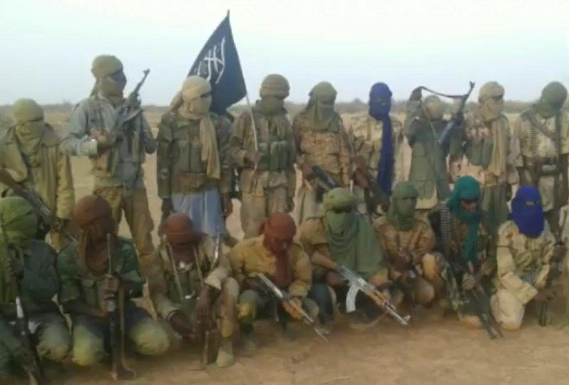
INTRODUCTION CONT’D
Activities of Islamic State in Syria and the Greater Sahara (ISIS-GS), Jama’at Nasr al-Islam wal Muslimin (JNIM), al-Murabitoun, Macina Liberation Front and Ansar al-Dine have been implicated for complex attacks on peacekeeping facilities, worship centres, public transport systems and military bases.
Source: www.google.com

Slide 24
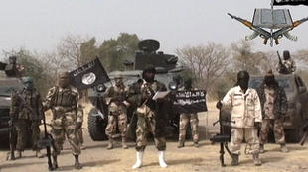
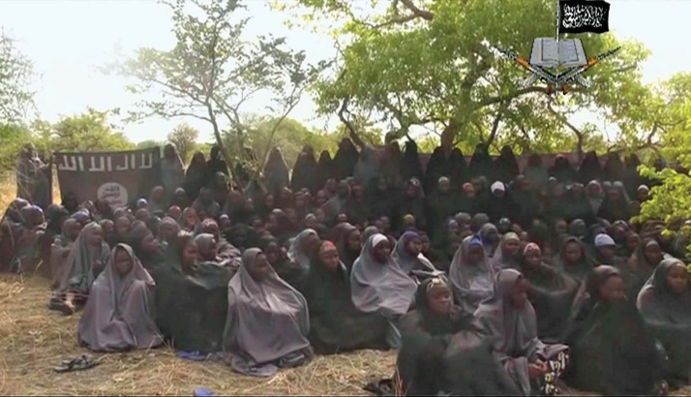
INTRODUCTION CONT’D
In Nigeria, the Jama’tul Ahlis Sunnah Lidda’a Wati wal-Jihad otherwise known as Boko Haram has carried out several attacks and still active.
For Boko Haram terrorist group to have carried out the numerous attacks recorded, it requires significant funding.
Source: www.google.com

Slide 25
INTRODUCTION CONT’D
Since 2009, Boko Haram has terrorized the Nigerian State with excruciating well-coordinated attacks.
How the group has conducted attacks and sacked military and police infrastructures, communities and facilities owned by national and international organizations is a signal to its sophistication enabled by access to funds.
This has allowed it to demonstrate it lethality and ferociousness which remain mind-boggling.
This is coupled with the fact that the country is yet to record a notable case of conviction for terrorism financing.

Slide 26
INTRODUCTION CONT’D
In 2013, Boko Haram was ranked the 7th richest terrorist group in the world.
In 2020, Boko Haram still maintained its position as the 3rd most dangerous terrorist organization in the world (Global Terrorism Index, 2020).
Despite the efforts of the Federal Government, Law Enforcement Agencies (LEAs) and financial institutions like the Central Bank of Nigeria (CBN), Nigerian Financial Intelligence Unit (NFIU) and Special Control Unit Against Money Laundering (SCUML), the menace persists.

Slide 27

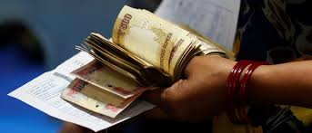
INTRODUCTION CONT’D
Financing terrorism is done in such a covert way that detecting it is not only confusing but also time consuming as the web of moving slush money and other assets is complex.
The methods of raising funds can be legitimate and illegitimate (Trippl, 2015).
Source: www.google.com

Slide 28
INTRODUCTION (CONT’D)
Terrorist organisations have emerged in South-East Asia over the years.
Examples: the Arakan Rohingya Salvation Army (ARSA) in Myanmar, Front Pembela Islam (FPI) in Indonesia, Moro National Liberation Front (MNLF) in Philippines and Patani United Liberation Organization (PULO) in Thailand.

Slide 29
INTRODUCTION (CONT’D)
According to the Global Terrorism Index (GTI, 2020), sub-Saharan Africa (SSA) which is home to ECOWAS nations is the most insecure part of the world due largely to the activities of violent extremists that operate with increased tensions, fatalities and displacements.
Terrorism is a menace to all 15 ECOWAS nations and a serious security challenge in at least 4 of them namely Nigeria, Mali, Burkina Faso and Cameroon which are ranked 2nd, 11th, 12th and 13th on the GTI (2020).

Slide 30
INTRODUCTION (CONT’D)
According to the 2020 GTI terrorism has greatly increased in recent years in West Africa, especially in the Lake Chad Basin and the Sahel.
Groups like Boko Haram in Nigeria, Al-Qaeda in the Islamic Maghreb (AQIM) and Islamic State in Greater Sahara (ISGS) in Mali and surrounding nations are challenging the security architecture in countries where they are domiciled and threatening peace and security in West Africa.

Slide 31
INTRODUCTION (CONT’D)
Moreso, 7 of the 10 countries with increase in terrorism are in the SSA.
They are: Burkina Faso, Mozambique, Democratic Republic of Congo (DRC), Niger, Cameroon and Ethiopia (GTI, 2020).
4 of these countries i.e. Burkina Faso, Niger, Cameroon and Nigeria are located in West Africa.

Slide 32
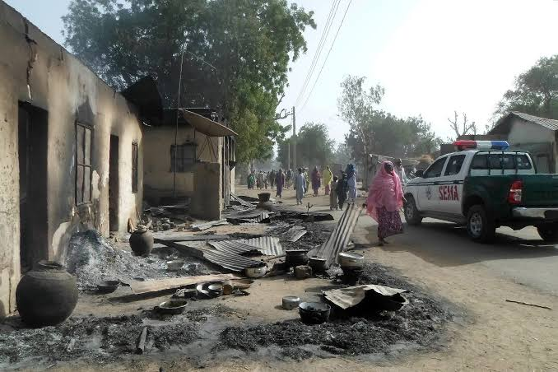
INTRODUCTION (CONT’D)
Their presence and increase is blamed on the expansion of Islamic State of Iraq and the Levant (ISIL) affiliates into SSA which has caused a surge in terrorism in many countries in the region.
The United States’ Country Reports on Terrorism 2020 indicated that ISIS-affiliated attacks in West Africa by ISWAP led to 5,000 deaths in 2020 which is an increase from the 2,700 recorded in 2017.
Source: www.google.com

Slide 33
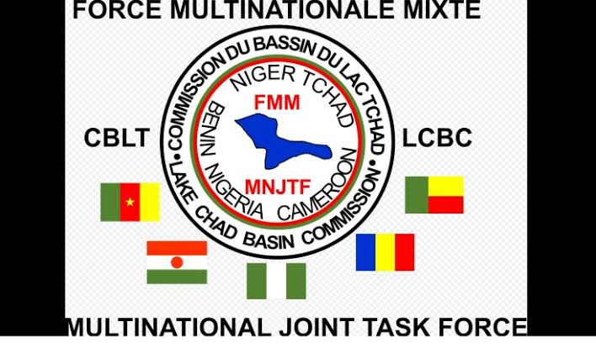
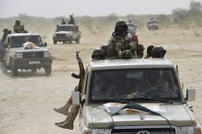
INTRODUCTION (CONT’D)
The need to identify and neutralise this threat has remained a critical concern for authorities, national governments of ECOWAS, West Africans and the international community.
Source: www.google.com

Slide 34
AIM
The aim of this paper is to discuss terrorism and terrorist financing in West Africa with a view to proffering solutions to the menace.

Slide 35
DEFINITION OF TERMS
Terrorism: The African Union (AU). Article 1 (3) of the AU Convention, defines terrorism as:
  “Any act which is a violation of the criminal laws of a State Party and which may endanger the life, physical integrity or freedom of, or cause serious injury or death to, any person, any number or group of persons or causes or may cause damage to public or private property, natural resources, environmental or cultural heritage and its calculated or intended to intimidate, put in fear, force, coerce or induce any government, body, institution, the general public, or any segment thereof, to do or abstain from doing any act, or to adopt or abandon a particular standpoint, or to act according to certain principles” (Gbevlo-Lartey, 2016).

Slide 36
DEFINITION OF TERMS
Terrorism Financing: The United Nations Office on Drugs and Crime (UNODC, 2019) simplified the concept as means and methods employed by terrorist organisations for administrative, organisational and operational purposes.
In other words, terrorist financing has moved from its conventional meaning of giving cash to fund terrorist organisations to providing any form of support directly or indirectly towards planning and executing a terror attack.

Slide 37
TERRORIST ORGANISATIONS IN WEST AFRICA
Al-Qaeda in the Lands of the Islamic Maghreb (AQIM)
Headed by Ubaidah Youssef al-Annabi, AQIM is based in the Northern part of Africa.
The terrorist group was established by Hassan Hattab in 1998 as the Salafist Organisation for Call and Combat.

Slide 38
TERRORIST ORGANISATIONS IN WEST AFRICA (CONT’D)
Following its affiliation with Al-Qaeda, it was renamed AQIM in January, 2007.
Its places of operation are Tunisia, Morocco, Algeria, Mauritania, Niger and Mali (FATF, 2016).

Slide 39
TERRORIST ORGANISATIONS IN WEST AFRICA (CONT’D)
Islamic State in the Greater Sahara (ISGS)
A splinter arm of Al- Mourabitoun, terrorist organisation allied with AQIM, ISGS came into limelight following its 2016 attacks in Niger and Burkina-Faso.
In October, 2016, ISIL acknowledged the group as a regional affiliate after its leader, Adnan Abu Walid al Sahrawi pledged allegiance to Abu Bakr al-Baghdadi, the former head of ISIL.

Slide 40
TERRORIST ORGANISATIONS IN WEST AFRICA (CONT’D)
ISGS has carried out 43 attacks across Niger, Mali and Burkina-Faso. The attacks have caused 266 deaths. Nearly half of the attacks took place in Mali with more than 127 fatalities. Most of the deaths in Mali happened in 2018, with an increase in kidnapping for ransom and armed assaults by the group (GTI, 2020).

Slide 41
TERRORIST ORGANISATIONS IN WEST AFRICA (CONT’D)
Jama’at Nasr al-Islam wal Muslimin (JNIM)
Formed in 2017, JNIM is a coalition of 4 salafist-jidahist fundamentalists namely Katibat Macina, Ansar Dine, al-Mourabitoun and the Saharan branch of AQIM.
It is known to operate from rural camps situated throughout Central and Northern part of Mali.

Slide 42
TERRORIST ORGANISATIONS IN WEST AFRICA (CONT’D)
JNIM has claimed attacks in Burkina Faso, Niger and Mali.
The group cooperates with other terrorist groups, especially the ISGS and Burkina-Faso based Ansaroul Islam.

Slide 43
TERRORIST ORGANISATIONS IN WEST AFRICA (CONT’D)
Jama’at Nasr al-Islam wal Muslimin (JNIM)
In the first 4 months of 2019, the group recorded an average of 32 attacks across Mali, Niger and Burkina-Faso, compared with the 41 and 59 cases within the same period in 2020 and 2021 respectively (Centre for Strategic and International Studies, 2021; International Crisis Group, 2021).

Slide 44
TERRORIST ORGANISATIONS IN WEST AFRICA (CONT’D)
Jama’tul Ahlis Sunnah Lidda’a Wati wal-Jihad
Jama’tul Ahlis Sunnah Lidda’a Wati wal-Jihad popularly known as Boko Haram and its affiliate groups namely the Islamic State of West African Province (ISWAP) and the followers of Abubakar Shekau are dreaded groups in Nigeria and neighbouring countries in the Lake Chad region.

Slide 45
TERRORIST ORGANISATIONS IN WEST AFRICA (CONT’D)
Jama’tul Ahlis Sunnah Lidda’a Wati wal-Jihad
The group is averse to western education. Boko Haram; the dominant group in west Africa is responsible for more than 37,500 deaths, over 2.6 million displaced persons and destruction of property worth millions of dollar (GTI, 2020).

Slide 46
TERRORISM FINANCING
Without terrorist financing there will be no terrorism;
If terrorist attacks are high, TF is in-turn high. Without funding terrorist activities cannot be sustained;
TF occurs largely in Designated Non Financial Businesses and Professions (DNFBPs) sector (Nigeria TF Typology Report 2013); and
Countries in west Africa have not recorded much success in prosecution/conviction of TF as funds are not channeled through the formal financial institutions.

Slide 47
TERRORIST FINANCING
Even the then President of Somalia, Hassan Sheikh Mohamud confirmed that Al-Shabaab trains Boko Haram fighters.
Like Boko Haram, AQIM has operational camps in some areas of Western Africa and it has been able to forge tactical alliances with MUJAO, Boko Haram, etc.

Slide 48
TERRORIST FINANCING
These coalitions include logistical support and training of terrorist members.
Apart from this, there are indications that such groups are supported by some public officials, politicians, civil and non-civil groups and some members of the society (FATF, 2013, 2016).

Slide 49

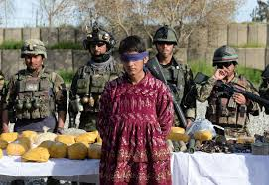
TERRORIST FINANCING
These individuals and groups aid and abet terrorist organisations through provision of accommodation, propagating their ideologies, supporting and providing recruits to carry out attacks.
Source: www.google.com

Slide 50
CAUSES OF TERRORISM
Poverty;
Ignorance;
Religious Extremism;
Bad governance;
Politics of Bitterness;
Corruption, among others

Slide 51
EFFECTS OF TERRORISM AND TERRORISM FINANCING
Wanton loss of lives
Destruction of property and infrastructure worth billions of dollars;
Displacement of millions of persons (e.g. Nigerians) with attendant strain placed on the government to maintain Internally Displaced Persons (IDPs) in various camps;
Loss of Foreign Direct Investments (FDIs) as big businesses, investors, multi nationals and numerous business opportunities for fear of insecurity;

Slide 52
EFFECTS OF TERRORISM AND TERRORISM FINANCING CONT’D
Threat to nation’s food security as farmlands are abandoned by fleeing farmers while farms/farm produce are destroyed by terrorists;
Disruption of the education process as schools and other institutions remain closed, thereby increasing illiteracy levels, which in-turn provide an avenue for easy indoctrination by terrorist elements

Slide 53
EFFECTS OF TERRORISM AND TERRORISM FINANCING CONT’D
High risk of exposure of civilians in IDP camps to social vices and epidemics;
Undermines the populace, create in them fear that the government cannot protect them; and
Negative image for the countries and sub region in the international arena.

Slide 54
SOURCES OF FUND
ILLEGITIMATE
Kidnapping for ransom
Sale of dry fish at the Lake Chad Basin
Sale of petroleum products
Bank robberies
Cattle rustling
Sale of vehicles
Raid of villages for food items and logistics
Smuggling

Slide 55
SOURCES OF FUND
ILLEGITIMATE
Begging
Human trafficking
Foreign sponsorship
Extortion
Levy on communities/farmers
Tax villages

Slide 56
SOURCES OF FUND
LEGITIMATE
Voluntary membership contribution
Compulsory levies imposed on members
Donation by sympathizers – charities
Profit from legitimate business

Slide 57
USE OF FUND
OPERATIONS:
Training;
Purchase of arms and ammunitiion and IED materials etc;
Procurements of operational houses, vehicles etc; and
Propaganda.

Slide 58
USE OF FUND CONT’D
ADMINISTRATION:
Salaries;
Acquisition of secretariat, furnishing and procuring office equipment and materials;
Disbursing free interest loans to members and those targeted for recruitment; and
Giving succor to orphaned children and widows of deceased members.

Slide 59
USE OF FUND CONT’D
Diversion of funds to private use:
Financial corruption in the enclave of BH and diversion of operations money to private use.

Slide 60

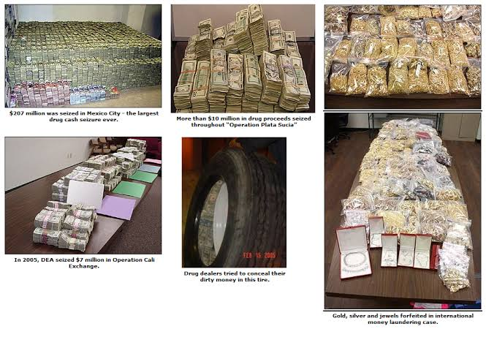
METHODS OF MOVING FUNDS
Movement of physical cash – trusted couriers;
Bank transfers – use of proxy accounts instance;
Exchange of goods; and
Cryptocurrencies.
Source: www.google.com

Slide 61
EFFORTS IN THE FIGHT AGAINST TERRORISM FINANCING
Terrorism prevention (freezing of international terrorist funds and other related matters) Regulation, 2013;
National Counter Terrorism Strategy e.g (NACTEST 2014);
Various Memoranda of Understanding (MoU), Bilateral and Multi-lateral treaties have been entered into to facilitate international support and cooperation to fight TF and ML among other crimes

Slide 62
EFFORTS IN THE FIGHT AGAINST TERRORISM FINANCING CONT’D
Enhanced intelligence gathering (Human and Technical intelligence);
Proscription of the sects;
Declaration of emergency rule;
Neighborhood policing: mobilization of local communities, vigilantes/local hunters in the affected States to combat the sect’s activities;
Creation of new army divisions (e.g. in Borno (7 Div) in August, 2013);
Collaboration among neighbouring countries through the multi-national Task Force to combat the sect’s activities;

Slide 63
EFFORTS IN THE FIGHT AGAINST TERRORISM FINANCING CONT’D
Massive military onslaught on identified camps, facilities and enclaves of terrorists;
Prosecution of arrested suspected terrorists;
Immigration control: through;
Watch-listing measures to apprehend terrorists on transits, and/or stop some from entering or leaving the country;
Introduction of Almajiri schools to reduce the level of illiteracy in the affected States and check conscription of these youths in Nigeria;

Slide 64
EFFORTS IN THE FIGHT AGAINST TERRORISM FINANCING CONT’D
Intensifying public awareness and sensitization with a view to increasing security consciousness and improving confidence in the populace;
Aggressive implementation of youth empowerment programmes like Subsidy Reinvestment and Empowerment Programme (SURE-P), N-POWER, Agricultural Programmes, infrastructural development and others with a view to reducing areas of discontents;
Increased support to security agencies to enhance their capacity to combat the threat.

Slide 65
EFFORTS IN THE FIGHT AGAINST TERRORISM FINANCING CONT’D
De-radicalization and Countering Violent Extremism (CVE) programmes at communities and detention facilities;
Procurement of arm and ammunition and other logistics for the LEAs and military;
Ratification of International Conventions on Prevention of Terrorism;
Anti-money laundering/combating the financing of terrorism (AML/CFT) regime;
Terrorism Prevention Act (TPA);

Slide 66
EFFORTS IN THE FIGHT AGAINST TERRORISM FINANCING CONT’D
Regulations/Censorship of Inciting Preaching;
Perception management by Government;
Administration of Criminal Justice Act;
Establishment of civilian joint taskforce;
Establishment of NFIUs, RIFU and other relevant Departments

Slide 67
EFFORTS IN THE FIGHT AGAINST TERRORISM FINANCING CONT’D
The initiation, development and partial implementation of the 2012 regional Counter-Terrorism Action Plan, 2013 adoption of the ECOWAS Counter-Terrorism Strategy and its Implementation Plan, establishment of the Multi-National Joint Task Force (MNJTF) and the Political Declaration on a Common Position against Terrorism are worthy of mention.

Slide 68
EFFORTS IN THE FIGHT AGAINST TERRORISM FINANCING CONT’D
With a US$2.3 billion budget, the strategy is premised on 8 priority areas including coordination of counter-terrorism initiatives, promotion of inter-community dialogue and prevention of violent extremism (Institute for Security Studies, 2021).

Slide 69
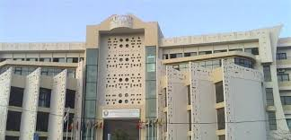

EFFORTS IN THE FIGHT AGAINST TERRORISM FINANCING CONT’D
Quite notable is the efforts of the Inter-Governmental Action Group against Money Laundering (GIABA) saddled with strengthening the capacity of ECOWAS nations for the prevention of terrorists and their financing means.
A recent ECOWAS strategy to combat the menace is the 2020-2024 Action Plan initiated in 2019.
Source: www.google.com

Slide 70
EFFORTS IN THE FIGHT AGAINST TERRORISM FINANCING CONT’D
At the national level, governments have empowered and created relevant security agencies, fostered legal instruments, initiated and adopted essential legislative, administrative and statutory steps.
In the region, some governments like Niger, Cameroon and Nigeria have established Financial Intelligence Units (FIUs) to detect, track and collaboratively apprehend suspects facilitating terrorism financing.

Slide 71
EFFORTS IN THE FIGHT AGAINST TERRORISM FINANCING CONT’D
In Nigeria, the 2004 Economic and Financial Crimes (Establishment) Act, 2011 Money Laundering (Prohibition) Act, 2011, Terrorism Prevention Act further amended in 2013, National Drug Law Enforcement Agency (NDLEA) Act and 2015 Proceed of Crimes Act are efforts to counter terrorism and its financing means.
Also similar is the creation of the National Action Plan for Preventing and Countering Extremism (NAPPCVE).

Slide 72
EFFORTS IN THE FIGHT AGAINST TERRORISM FINANCING CONT’D
Within communities, grassroots network subsists to gather intelligence and share with security agencies. Formation and operation of vigilante groups, public enlightenment using print and electronic media as well as reporting suspicious activities to constituted authorities were also utilized.
Corporate entities are also playing their part through offering humanitarian services to victims of terrorist attacks.

Slide 73
EFFORTS IN THE FIGHT AGAINST TERRORISM FINANCING CONT’D
These organisations are likewise directly or indirectly involved in government processes to tackle the menace.
Their presence are most noticeable in sponsoring campaigns against terrorism and terrorism financing, educating the populace and providing support to persons affected by terrorism e.g. NEMA, Refugee Commission, NGOs, Ministry of Humanitarian Affairs and Disaster Management etc.

Slide 74
CHALLENGES
Unwillingness of some members of the public in providing security agencies with information for fear of being traced and killed by the group;
Propaganda by the group;
Poverty;

Slide 75
CHALLENGES CONT’D
Porous international borders;
Trans-nationalities of perpetrators of terrorism;
Low literacy level;
Religious manipulation;
Economic exploitation;
Unemployment;
Terrain in the region;
Unconventional/guerrilla nature of terrorist attacks;
Lack of initial support from the populace;

Slide 76
CHALLENGES CONT’D
Politicization of the crisis;
Poor logistics;
Absence of sanction committee;
cash based economy of the sub-region;
Inter-agency rivalry;
Contiguous nationalities;
Inadequate training/capacity building; and
Corruption.

Slide 77
CHALLENGES CONT’D
Belief in some quarters that ECOWAS appears ill-equipped to tackle emerging threats and react in a timely manner to the menace.
The regional body is also bedeviled by inadequate resources.

Slide 78
CHALLENGES (CONT’D)
It is believed that it lacks the requisite funds to prosecute the war against terrorism and terrorism financing in the region.

Slide 79
CHALLENGES (CONT’D)
The Coronavirus Disease 2019 (COVID-19) pandemic is a related issue affecting counter-terrorism and counter-terrorism financing plans, many nations are faced with financial and economic issues.
Its outbreak has shifted the attention of member states as their national budgets have been strained by the unforeseen need to provide urgent relief to their citizens.

Slide 80
CHALLENGES (CONT’D)
Without doubt, ending terrorism and its financing is a complex, long-term mission that needs significant investment of money and time.

Slide 81
CHALLENGES (CONT’D)
Another factor is the near silence of the ECOWAS counter-terrorism and counter-terrorism financing plan on ways to tackle the root causes of the menace.
The dearth of resources on the part of sub-regional institutions and member states is also hampering anti-terrorism and CTF plans. Human and material requirements to fight terrorist organisations are inadequate.

Slide 82
WAY FORWARD
Reduction in area of discontent;
Investment in technology;
Training and retraining of security personnel;
Modern fighting equipment and logistics;
Community policing;
Improve database;
Creation of jobs;
Security education;

Slide 83
WAY FORWARD CONT’D
Social security programme must be pursued;
Improved welfare for troops; and
Food tech – processed (canned) food to troop.

Slide 84
WAY FORWARD
The solutions must be political as they are military.
As a starting point, the focus must shift to tackling poor governance and development which are the bedrocks of tackling the crime. A key driver to stem the tide is to ensure timely, effective and efficient use of technology. This owes to its potential to make counter-terrorism and CTF efforts more efficient, faster and cheaper.

Slide 85
CONCLUSION
Terrorist will continue to have a field day in West African nations if their means and methods of financing are not properly checked. As much as counter-terrorism and CTF efforts must be realistic, it is very necessary to ensure that the region is developed and raised to the standards of its contemporaries in developed parts of the world.

Slide 86
CONCLUSION (CONT’D)
By so doing, regional, national and sub-national governments in collaboration with private entities would have created a conducive atmosphere where people and businesses can thrive peacefully. The result is that not only will terrorism be eradicated, other crimes will be greatly reduced. It therefore behoves on the governments and relevant institutions to walk the talk and elevate the region to an enviable place in social, economic and political development

Slide 87
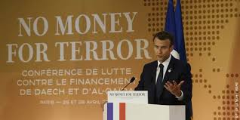
Source: www.google.com

Slide 88
THANK YOU
FOR
YOUR
ATTENTION

Slide 89
REFERENCES
Gbevlo-Lartey, L. (2016). African Union Policies on Combating Terrorism and Extremism on the Continent. Retrieved from https://www.caert.org.dz
International Crisis Group. (2020). Mali: Enabling Dialogue with the Jihaist Coalition JNIM. Being an African Report Nº306
Institute for Security Studies. (2021). Slow Progress for West Africa’s Latest Counter-Terrorism Plan. Retrieved from https://issafrica.org/iss- today/slow-progress-for-west- africas-latest-counter-terrorism-plan

Slide 90
Centre for Strategic and International Studies. (2020). Examining Extremism: Jama’at Nasr al-Islam wal Muslimin. Retrieved from https://www.csis.org/blogs#
United Nations. (1999). International convention for the suppression of the financing of terrorism. Retrieved from https://www.google.com/search?q=International+Convention+fo r+the+Suppression+of+the+Financing+of+Terrorism&oq=International+Convention+for+the+Suppression+of+the+Financing+of+Terrorim&aqs=chrome..69i57j35i39i362l8...8.426j0j7&sourceid=chrome&ie=UTF-8#

Slide 91
Izuagbe, R. (2021). Terrorism Financing and National Security in Nigeria. Being a project submitted to the National Institute for Security Studies (NISS), Bwari, Abuja
United Nations Office on Drugs and Crime. (2019). Combating Terrorism Financing. Retrieved from https://www.unodc.org/unodc/en/terrorism/expertise/combatin g-terrorist-financing
United Kingdom. (2021). Terrorism: Nigeria Travel Advice. Retrieved from https://www.gov.uk
Financial Action Task Force. (2013). Terrorist Financing in West Africa. Retrieved from https://www.fatfgafi.org/publications/methodsandtrends/docu ments/tf-west-africa.html

Slide 92
Financial Action Task Force. (2016). Terrorist Financing in West and Central Africa. Retrieved from https://www.fatfgafi.org/media/fatf/documents/reports/Terroris t-Financing-West-Central-Africa.pdf
Jenkins, J. P. (2007). Terrorism. Retrieved from https://www.britannica.com/topic/terrorism
International Centre for Counter-Terrorism. (2020). The Use of Small Arms and Light Weapons by Terrorist Organisations as a Source of Finance in the South and Southeast Asia. Being a Situation Report, the Hague Netherlands.
United States of America. Country Reports on Terrorism. (2020). Retrieved from https://www.state.gov/reports/country-reports-on- terrorism-2020/

Slide 93
Institute for Economics and Peace. (2020). Global Terrorism Index – Measuring the Impact of Terrorism. Retrieved from https://www.visionofhumanity.org/wp- content/uploads/2020/11/GTI- 2020-web-1.pdf
United Nations Development Programme. (2020). Entry and Exit Points: Violent Extremism in South-East Asia. Retrieved from https://www.undp.org/content/dam/undp/library/km- qap/UNDP-RBAP-Violent-Extremism-in-SE-Asia-Entry-and-Exit- Points-2020.pdf
United Nations. (2005). Various Definitions of Terrorism. Retrieved from https://www.dema.az.gov

